Slide 1
Diabetes Prediction Using Machine Learning
Shubhangi Arun Gaikwad

Slide 2
ABSTRACT
Diabetes is a chronic disease with the potential to cause a worldwide health care crisis. According to International Diabetes Federation 382 million people are living with diabetes across the whole world. By 2035, this will be doubled as 592 million. Diabetes is a disease caused due to the increase level of blood glucose. This high blood glucose produces the symptoms of frequent urination, increased thirst, and increased hunger. Diabetes is a one of the leading cause of blindness, kidney failure, amputations, heart failure and stroke. When we eat, our body turns food into sugars, or glucose. At that point, our pancreas is supposed to release insulin. Insulin serves as a key to open our cells, to allow the glucose to enter and allow us to use the glucose for energy. But with diabetes, this system does not work.

Slide 3
The aim of this project is to develop a system which can perform early prediction of diabetes for a patient with a higher accuracy by combining the results of different machine learning techniques. The algorithms like K nearest neighbour, Logistic Regression, Random forest, Support vector machine and Decision tree are used. The accuracy of the model using each of the algorithms is calculated. Then the one with a good accuracy is taken as the model for predicting the diabetes. Keywords : Machine Learning, Diabetes, Decision tree, K nearest neighbour, Logistic Regression, Support vector Machine, Accuracy

Slide 4
I. INTRODUCTION
Diabetes is the fast growing disease among the people even among the youngsters. In understanding diabetes and how it develops, we need to understand what happens in the body without diabetes. Sugar (glucose) comes from the foods that we eat, specifically carbohydrate foods. Carbohydrate foods provide our body with its main energy source everybody, even those people with diabetes, needs carbohydrate. Carbohydrate foods include bread, cereal, pasta, rice, fruit, dairy products and vegetables (especially starchy vegetables). When we eat these foods, the body breaks them down into

Slide 5
Symptoms of Diabetes
• Frequent Urination
• Increased thirst
• Tired/Sleepiness
• Weight loss
• Blurred vision
• Mood swings
• Confusion and difficulty concentrating • frequent infections

Slide 6
Causes of Diabetes
Genetic factors are the main cause of diabetes. It is caused by at least two mutant genes in the chromosome 6, the chromosome that affects the response of the body to various antigens. Viral infection may also influence the occurrence of type 1 and type 2 diabetes. Studies have shown that infection with viruses such as rubella, Coxsackievirus, mumps, hepatitis B virus, and cytomegalovirus increase the risk of developing diabetes.

Slide 7
METHODOLOGY
In this section we shall learn about the various classifiers used in machine learning to predict diabetes. We shall also explain our proposed methodology to improve the accuracy. Five different methods were used in this project The different methods used are defined below. The output is the accuracy metrics of the machine learning models. Then, the model can be used in prediction.
Dataset Description The diabetes data set was originated from https://www.kaggle.com/johndasilva/diabetes. Diabetes dataset containing 2000 cases. The objective is to predict based on the measures to predict if the patient is diabetic or not

Slide 8
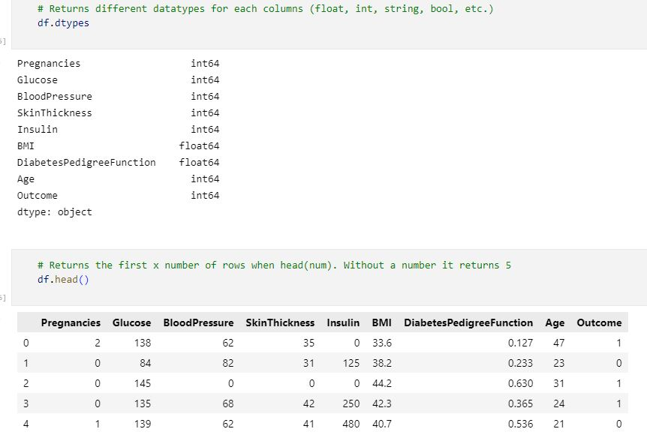
➔ The diabetes data set consists of 2000 data points, with 9 features each. ➔ “Outcome” is the feature we are going to predict, 0 means No diabetes, 1 means diabetes

Slide 9
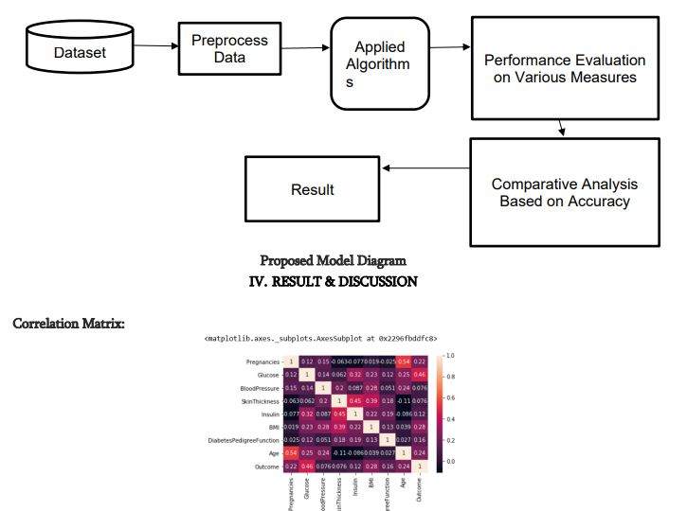

Slide 10
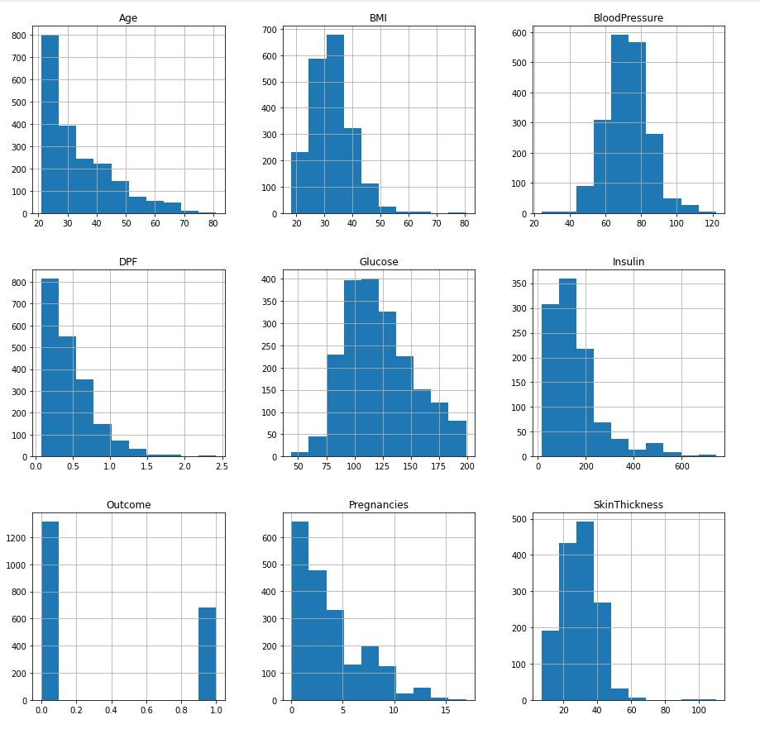
Histogram:

Slide 11
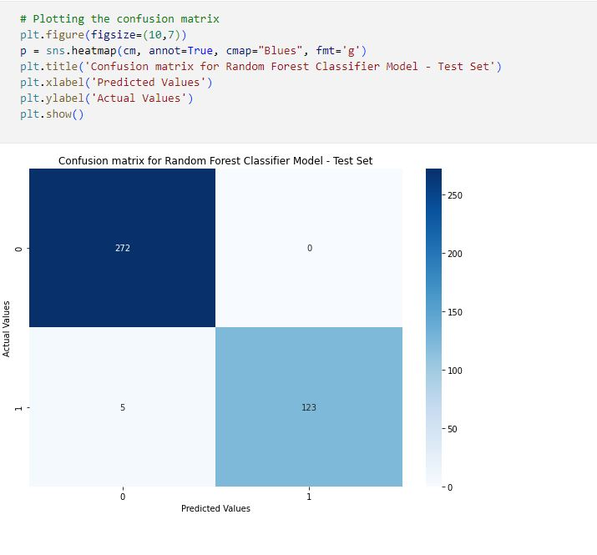

Slide 12
Random Forest Algorithm
Random Forest is a popular machine learning algorithm that belongs to the supervised learning technique. It can be used for both Classification and Regression problems in ML. It is based on the concept of ensemble learning, which is a process of combining multiple classifiers to solve a complex problem and to improve the performance of the model.
As the name suggests, "Random Forest is a classifier that contains a number of decision trees on various subsets of the given dataset and takes the average to improve the predictive accuracy of that dataset." Instead of relying on one decision tree, the random forest takes the prediction from each tree and based on the majority votes of predictions, and it predicts the final output.

Slide 13
Decision Tree: This classifier creates a decision tree based on which, it assigns the class values to each data point. Here, we can vary the maximum number of features to be considered while creating the model.
The accuracy on the training set is 100% and the test set accuracy is also good. Feature Importance in Decision Trees Feature importance rates how important each feature is for the decision a tree makes. It is a number between 0 and 1 for each feature, where 0 means “not used at all” and 1 means “perfectly predicts the target

Slide 14
Support Vector Machine
This classifier aims at forming a hyper plane that can separate the classes as much as possible by adjusting the distance between the data points and the hyper plane. There are several kernels based on which the hyper plane is decided. I tried four kernels namely, linear, poly, rbf, and sigmoid.

Slide 15
.
CONCLUSION AND FUTURE WORK
One of the important real-world medical problems is the detection of diabetes at its early stage. In this study, systematic efforts are made in designing a system which results in the prediction of diabetes. During this work, five machine learning classification algorithms are studied and evaluated on various measures.
Experiments are performed on john Diabetes Database. In future, the designed system with the used machine learning classification algorithms can be used to predict or diagnose other diseases. The work can be extended and improved for the automation of diabetes analysis including some other machine learning algorithms.

Slide 16
Thank you

